Slide 1
Wind Logistics Group Continuation of PhD Reference Group
Online web meeting
Altered meeting schedule (COVID-19)
Replacing 3rd face-to-face meeting
Venue: Online
Wind Logistics Group, Meeting #5, November 24, 2020
Global Wind Energy Shipping and Logistics PhD project Reference Group meeting (#15)

Slide 2
Speed boat update - Transport concept for big wind turbines
September 22, 2020 online call:
- decision to split in 3 sub-speed boats
Specifications for
existing and future
wind ports
Transport, lifting, and handling equipment
Wind vessels of the future

Slide 3
Speed boat update - Transport concept for big wind turbines
September 22, 2020 online call:
- decision to split in 3 sub-speed boats
Specifications for
existing and future
wind ports
Transport, lifting, and handling equipment
Wind vessels of the future

Slide 4
Specifications for existing and future wind ports - the basic idea
Evaluation of an existing or new port
Wind energy
Tool
Data entry
Traffic light notification of suitability

Slide 5
Our intention
Wind turbine yield per WTG is constantly being upscaled
Bigger dimensions
Heavier weights
Dillemma: Future proofing

Slide 6
Our tool is work in progress - examples of output from the tool
Graphs to predict the future
We would like to show developments over time
WTG model ”jumps” cause weight/dimensions to increase significantly; flatteneed over time as MW is upscaled for each WTG model
Blade length/weight
Blade length/blade root diameter
Nacelle yield/weight/size
Etc…
Tables with data from the past
Showing developments

Slide 7
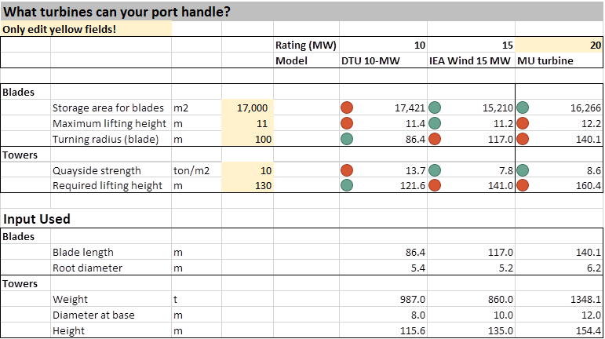
Our goal: Present and future ports

Slide 8
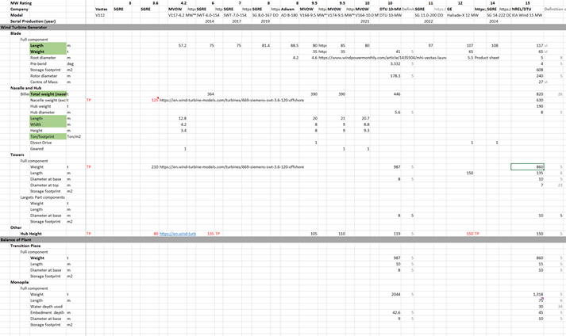
Big input section for desired outcome

Slide 9
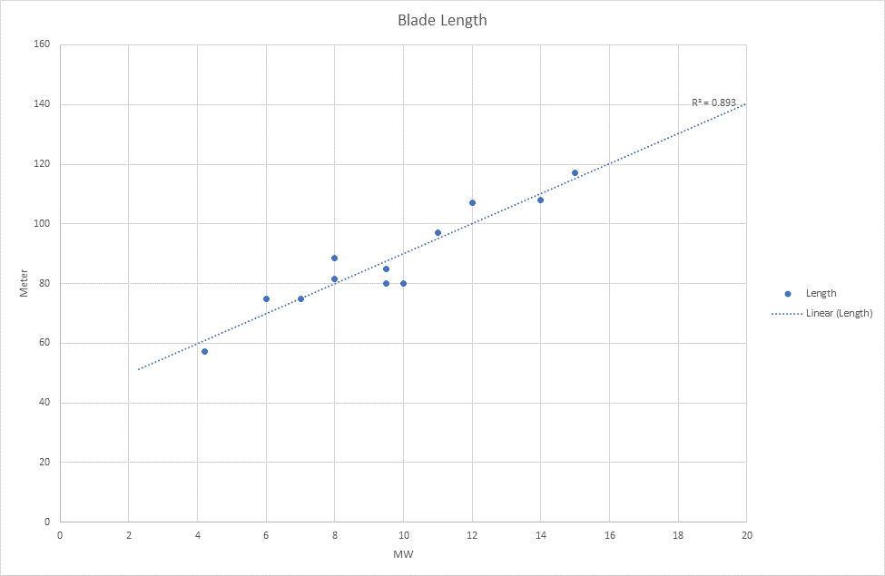
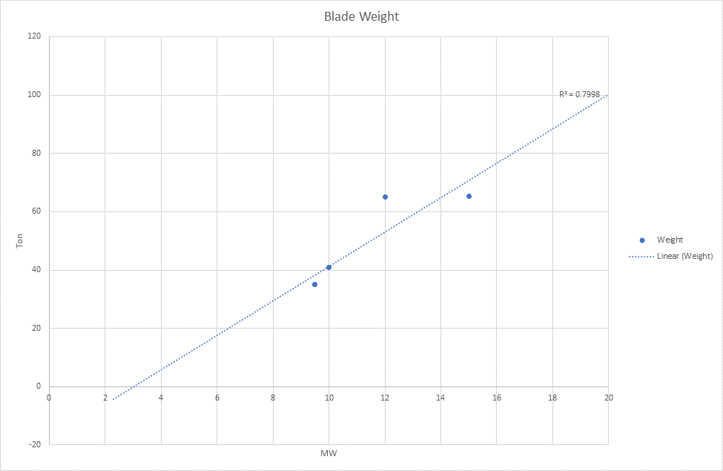
Understanding size and weight
How big is big enough?
Our output is only as good as the data we have available

Slide 10
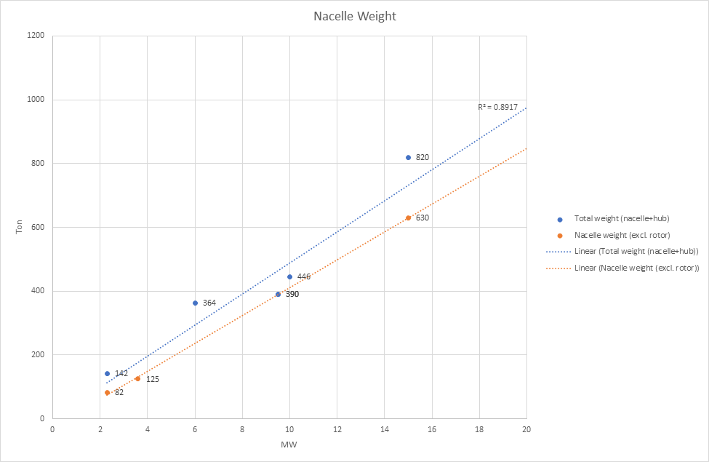
Indications on nacelle weigth when upscaling

Slide 11
Next steps
We would like for this to be an open source tool
Available online
It is not yet completed
To finalize the tool, we need:
Verfication/input on component data from OEM´s
Calculated projection based on current/updated data

Slide 12
Recommendation
We recommend to Wind Logistics Group that OEM´s are engaged
This can be done by support from Group members/network
The time it will take is 2-3 weeks[?]
If technical information from OEM´s is not available, we will engage e.g. DTU Wind Power to do the predictions
The cost of DKK 100-200K to carry out the prediction will be sourced from Energy Cluster Denmark under vidensbro (“knowledge bridge”) funding scheme

